Slide 1
CSC 2224: Parallel Computer Architecture and Programming
Memory Consistency &
Cache Coherence
Prof. Gennady Pekhimenko
University of Toronto
Fall 2019
The content of this lecture is adapted from the lectures of
Onur Mutlu @ CMU

Slide 2
No class Oct. 29 week
I am traveling to SOSP 2019

Slide 3
Reviews: Memory Consistency
Review:
  Lamport, “How to Make a Multiprocessor Computer That Correctly Executes Multiprocess Programs,” IEEE Transactions on Computers, 1979 (less than 2 pages)
  Boehm et al., “Foundations of the C++ Concurrency Memory Model”, PLDI 2008 (11 pages)

Slide 4
Memory Ordering in Multiprocessors

Slide 5
Ordering of Operations
Operations: A, B, C, D
  In what order should the hardware execute (and report the results of) these operations?
A contract between programmer and microarchitect
  Specified by the ISA
Preserving an “expected” (more accurately, “agreed upon”) order simplifies programmer’s life
  Ease of debugging; ease of state recovery, exception handling
Preserving an “expected” order usually makes the hardware designer’s life difficult
  Especially if the goal is to design a high performance processor: Load-store queues in out of order execution

Slide 6
Single Processor Ordering
Specified by the von Neumann model
Sequential order
  Hardware executes the load and store operations in the order specified by the sequential program
Out-of-order execution does not change the semantics
  Hardware retires (reports to software the results of) the load and store operations in the order specified by the sequential program
Advantages: 1) Architectural state is precise within an execution. 2) Architectural state is consistent across different runs of the program → Easier to debug programs
Disadvantage: Preserving order adds overhead, reduces performance

Slide 7
Dataflow Processor Ordering
A memory operation executes when its operands are ready
Ordering specified only by data dependencies
Two operations can be executed and retired in any order if they have no dependency
Advantage: Lots of parallelism → high performance
Disadvantage: Order can change across runs of the same program → Very hard to debug

Slide 8
MIMD Processor Ordering
Each processor’s memory operations are in sequential order with respect to the “thread” running on that processor (assume each processor obeys the von Neumann model)
Multiple processors execute memory operations concurrently
How does the memory see the order of operations from all processors?
  In other words, what is the ordering of operations across different processors?

Slide 9
Why Does This Even Matter?
Ease of debugging
  It is nice to have the same execution done at different times have the same order of memory operations
Correctness
  Can we have incorrect execution if the order of memory operations is different from the point of view of different processors?
Performance and overhead
  Enforcing a strict “sequential ordering” can make life harder for the hardware designer in implementing performance enhancement techniques (e.g., OoO execution, caches)

Slide 10
Protecting Shared Data
Threads are not allowed to update shared data concurrently
  For correctness purposes
Accesses to shared data are encapsulated inside
critical sections or protected via synchronization constructs (locks, semaphores, condition variables)
Only one thread can execute a critical section at
a given time
  Mutual exclusion principle
A multiprocessor should provide the correct execution of synchronization primitives to enable the programmer to protect shared data

Slide 11
Supporting Mutual Exclusion
Programmer needs to make sure mutual exclusion (synchronization) is correctly implemented
  We will assume this
  But, correct parallel programming is an important topic
  Reading: Dijkstra, “Cooperating Sequential Processes,” 1965.
Programmer relies on hardware primitives to support correct synchronization
If hardware primitives are not correct (or unpredictable), programmer’s life is tough
If hardware primitives are correct but not easy to reason about or use, programmer’s life is still tough

Slide 12
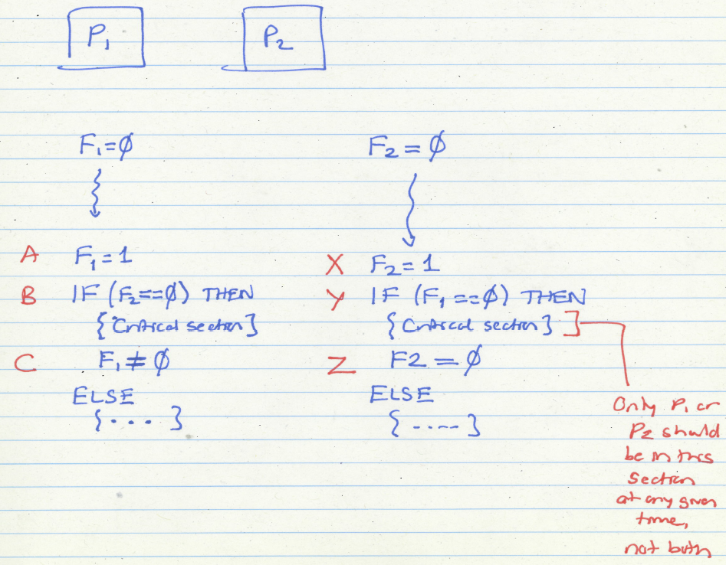
Protecting Shared
Data
Assume P1 is in critical section.
Intuitively, it must have executed A,
which means F1 must be 1 (as A happens before B),
which means P2 should not enter the critical section.

Slide 13
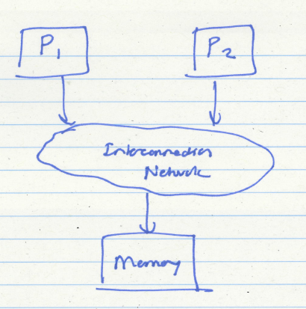
A Question
Can the two processors be in the critical section at the same time given that they both obey the von Neumann model?
Answer: yes

Slide 14
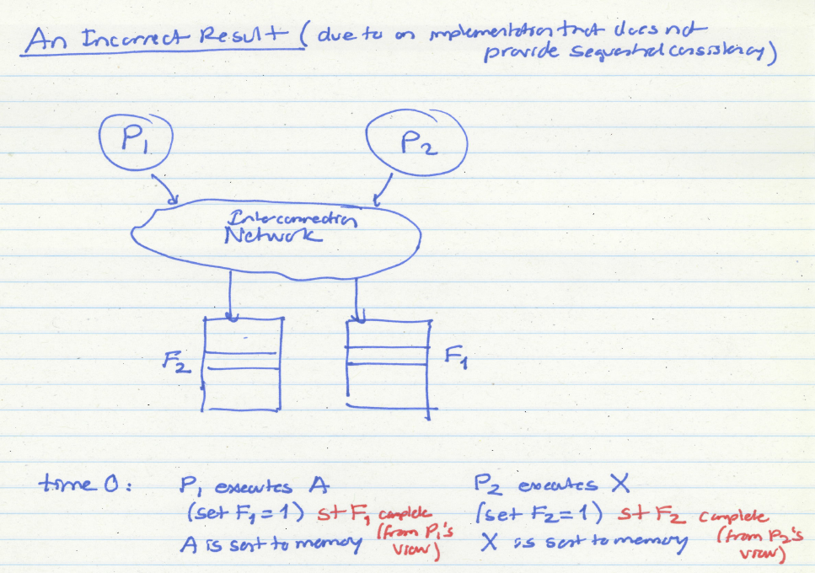

Slide 15
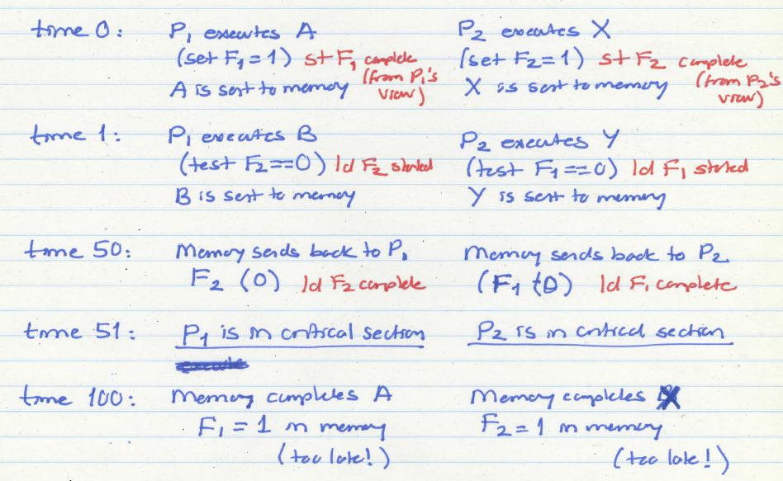
Both Processors in Critical Section

Slide 16
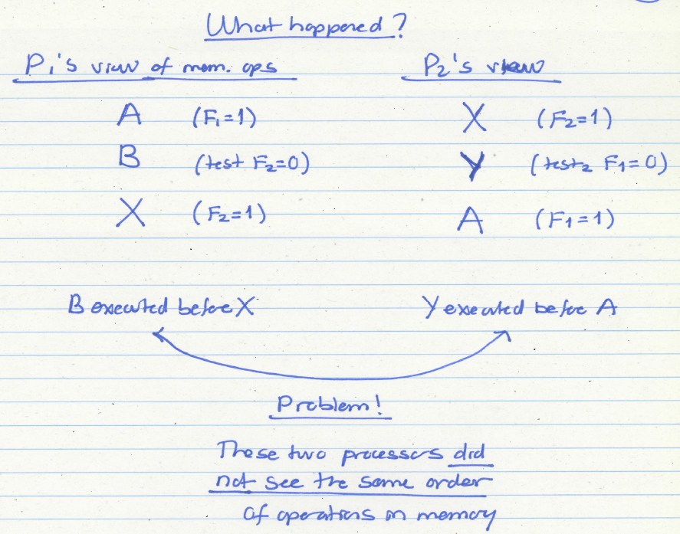

Slide 17
How Can We Solve The Problem?
Idea: Sequential consistency
All processors see the same order of operations to memory
i.e., all memory operations happen in an order (called the global total order) that is consistent across all processors
Assumption: within this global order, each processor’s operations appear in sequential order with respect to its own operations.

Slide 18
Sequential Consistency
  Lamport, “How to Make a Multiprocessor Computer That Correctly Executes Multiprocess Programs,” IEEE Transactions on Computers, 1979
A multiprocessor system is sequentially consistent if:
  the result of any execution is the same as if the operations of all the processors were executed in some sequential order
  AND
  the operations of each individual processor appear in this sequence in the order specified by its program
This is a memory ordering model, or memory model
    Specified by the ISA

Slide 19
Programmer’s Abstraction
Memory is a switch that services one load or store at a time form any processor
All processors see the currently serviced load or store at the same time
Each processor’s operations are serviced in program order

Slide 20
Sequentially Consistent Operation
Potential correct global orders (all are correct):
A B X Y
A X B Y
A X Y B
X A B Y
X A Y B
X Y A B
Which order (interleaving) is observed depends on implementation and dynamic latencies

Slide 21
Consequences of Sequential Consistency
1. Within the same execution, all processors see the same global order of operations to memory
→ No correctness issue
→ Satisfies the “happened before” intuition
2. Across different executions, different global orders can be observed (each of which is sequentially consistent)
→ Debugging is still difficult (as order changes across runs)

Slide 22
Issues with Sequential Consistency?
Nice abstraction for programming, but two issues:
  Too conservative ordering requirements
  Limits the aggressiveness of performance enhancement techniques
Is the total global order requirement too strong?
  Do we need a global order across all operations and all processors?
  How about a global order only across all stores?
    Total store order memory model; unique store order model
  How about a enforcing a global order only at the boundaries of synchronization? Relaxed/Acquire-release consistency model

Slide 23
Issues with Sequential Consistency?
Performance enhancement techniques that could make SC implementation difficult
Out-of-order execution
  Loads happen out-of-order with respect to each other and with respect to independent stores
Caching
  A memory location is now present in multiple places
  Prevents the effect of a store to be seen by other processors

Slide 24
Weaker Memory Consistency
The ordering of operations is important when the order affects operations on shared data → i.e., when processors need to synchronize to execute a “program region”
Weak consistency
  Idea: Programmer specifies regions in which memory operations do not need to be ordered
  “Memory fence” instructions delineate those regions
    All memory operations before a fence must complete before the fence is executed
    All memory operations after the fence must wait for the fence to complete
    Fences complete in program order
  All synchronization operations act like a fence

Slide 25
Tradeoffs: Weaker Consistency
Advantage
  No need to guarantee a very strict order of memory operations
  → Enables the hardware implementation of performance enhancement techniques to be simpler
  → Can be higher performance than stricter ordering
Disadvantage
  More burden on the programmer or software (need to get the “fences” correct)
Another example of the programmer-microarchitect tradeoff

Slide 26
Cache Coherence

Slide 27
Shared Memory Model
Many parallel programs communicate through shared memory
Proc 0 writes to an address, followed by Proc 1 reading
  This implies communication between the two
Each read should receive the value last written by anyone
  This requires synchronization (what does last written mean?)
What if Mem[A] is cached (at either end)?
Proc 0
Mem[A] = 1
Proc 1
…
Print Mem[A]

Slide 28
Cache Coherence
Basic question: If multiple processors cache the same block, how do they ensure they all see a consistent state?
P1
P2
Interconnection Network
1000
x
Main Memory

Slide 29
The Cache Coherence Problem
P1
P2
ld r2, x
1000
Interconnection Network
1000
x
Main Memory

Slide 30
The Cache Coherence Problem
P1
P2
ld r2, x
ld r2, x
1000
1000
Interconnection Network
x
1000
Main Memory

Slide 31
The Cache Coherence Problem
P1
P2
ld r2, x
ld r2, x
add r1, r2, r4
st x, r1
2000
1000
Interconnection Network
1000
x
Main Memory

Slide 32
The Cache Coherence Problem
P1
P2
ld r2, x
ld r2, x
add r1, r2, r4
st x, r1
2000
1000
Should NOT load 1000
ld r5, x
Interconnection Network
1000
x
Main Memory

Slide 33
Cache Coherence: Whose Responsibility?
Software
  Can the programmer ensure coherence if caches are invisible to software?
  What if the ISA provided a cache flush instruction?
    FLUSH-LOCAL A: Flushes/invalidates the cache block containing address A from a processor’s local cache.
    FLUSH-GLOBAL A: Flushes/invalidates the cache block containing address A from all other processors’ caches.
    FLUSH-CACHE X: Flushes/invalidates all blocks in cache X.
Hardware
  Simplifies software’s job
  One idea: Invalidate all other copies of block A when a processor writes to it

Slide 34
A Very Simple Coherence Scheme
Caches “snoop” (observe) each other’s write/read operations. If a processor writes to a block, all others invalidate it from their caches.
A simple protocol:
PrRd/--
PrWr / BusWr
Write-through, no-write-allocate cache
Actions: PrRd, PrWr, BusRd, BusWr
Valid
BusWr
PrRd / BusRd
Invalid
PrWr / BusWr

Slide 35
(Non-)Solutions to Cache Coherence
No hardware based coherence
  Keeping caches coherent is software’s responsibility
  + Makes microarchitect’s life easier
  -- Makes average programmer’s life much harder
    need to worry about hardware caches to maintain program correctness?
  -- Overhead in ensuring coherence in software
All caches are shared between all processors
  + No need for coherence
  -- Shared cache becomes the bandwidth bottleneck
  -- Very hard to design a scalable system with low-latency cache access this way

Slide 36
Maintaining Coherence
Need to guarantee that all processors see a consistent value (i.e., consistent updates) for the same memory location
Writes to location A by P0 should be seen by P1 (eventually), and all writes to A should appear in some order
Coherence needs to provide:
  Write propagation: guarantee that updates will propagate
  Write serialization: provide a consistent global order seen by all processors
Need a global point of serialization for this store ordering

Slide 37
Hardware Cache Coherence
Basic idea:
  A processor/cache broadcasts its write/update to a memory location to all other processors
  Another cache that has the location either updates or invalidates its local copy

Slide 38
Coherence: Update vs. Invalidate
How can we safely update replicated data?
  Option 1 (Update protocol): push an update to all copies
  Option 2 (Invalidate protocol): ensure there is only one copy (local), update it
On a Read:
  If local copy isn’t valid, put out request
  (If another node has a copy, it returns it, otherwise memory does)

Slide 39
Update vs. Invalidate (2)
On a Write:
  Read block into cache as before
Update Protocol:
  Write to block, and simultaneously broadcast written data to sharers
  (Other nodes update their caches if data was present)
Invalidate Protocol:
  Write to block, and simultaneously broadcast invalidation of address to sharers
  (Other nodes clear block from cache)

Slide 40
Update vs. Invalidate Tradeoffs
Which do we want?
  Write frequency and sharing behavior are critical
Update
  + If sharer set is constant and updates are infrequent, avoids the cost of invalidate-reacquire (broadcast update pattern)
  - If data is rewritten without intervening reads by other cores, updates were useless
  - Write-through cache policy ➔ bus becomes bottleneck
Invalidate
  + After invalidation broadcast, core has exclusive access rights
  + Only cores that keep reading after each write retain a copy
  - If write contention is high, leads to ping-ponging (rapid mutual invalidation-reacquire)

Slide 41
Two Cache Coherence Methods
  How do we ensure that the proper caches are updated?
  Snoopy Bus [Goodman ISCA 1983, Papamarcos+ ISCA 1984]
    Bus-based, single point of serialization for all requests
    Processors observe other processors’ actions
      E.g.: P1 makes “read-exclusive” request for A on bus, P0 sees this and invalidates its own copy of A
  Directory [Censier and Feautrier, IEEE ToC 1978]
    Single point of serialization per block, distributed among nodes
    Processors make explicit requests for blocks
    Directory tracks ownership (sharer set) for each block
    Directory coordinates invalidation appropriately
      E.g.: P1 asks directory for exclusive copy, directory asks P0 to invalidate, waits for ACK, then responds to P1

Slide 42
Directory Based
Cache Coherence

Slide 43
Directory Based Coherence
Idea: A logically-central directory keeps track of where the copies of each cache block reside. Caches consult this directory to ensure coherence.
An example mechanism:
  For each cache block in memory, store P+1 bits in directory
    One bit for each cache, indicating whether the block is in cache
    Exclusive bit: indicates that a cache has the only copy of the block and can update it without notifying others
  On a read: set the cache’s bit and arrange the supply of data
  On a write: invalidate all caches that have the block and reset their bits
  Have an “exclusive bit” associated with each block in each cache

Slide 44
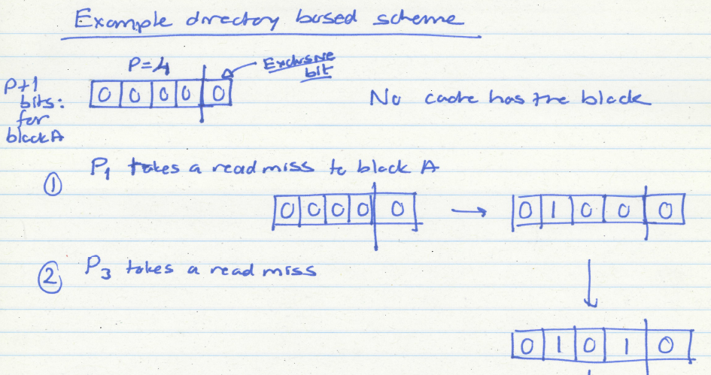
Directory Based Coherence Example (I)

Slide 45
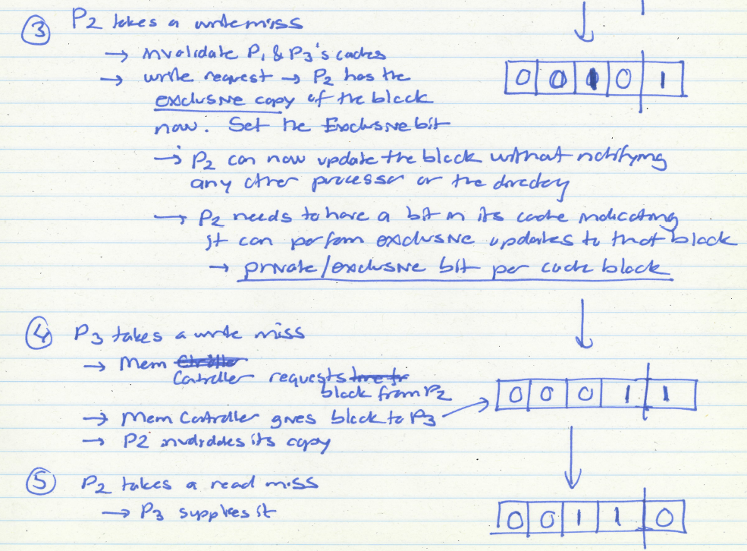
Directory Based Coherence Example (I)

Slide 46
Snoopy Cache Coherence

Slide 47
Snoopy Cache Coherence
Idea:
  All caches “snoop” all other caches’ read/write requests and keep the cache block coherent
  Each cache block has “coherence metadata” associated with it in the tag store of each cache
Easy to implement if all caches share a common bus
  Each cache broadcasts its read/write operations on the bus
  Good for small-scale multiprocessors
  What if you would like to have a 1000-node multiprocessor?

Slide 48
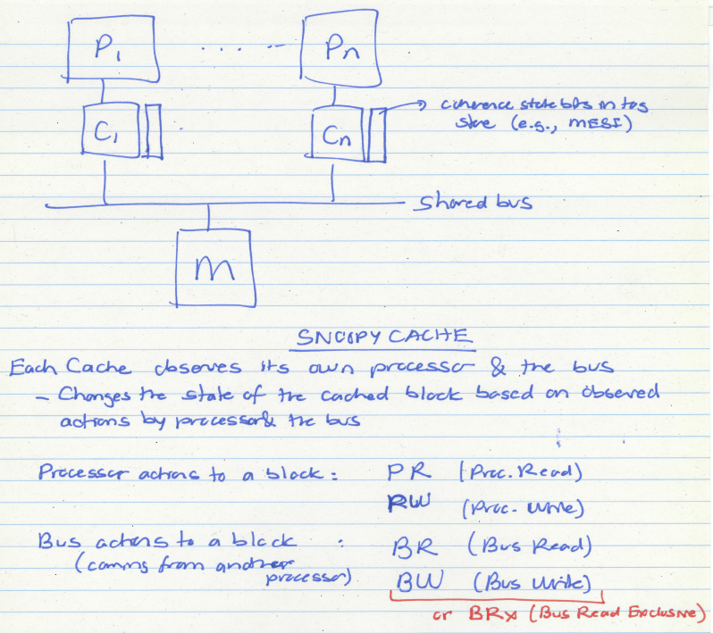

Slide 49
A Simple Snoopy Protocol
Caches “snoop” (observe) each other’s write/read operations
A simple protocol:
PrRd/--
PrWr / BusWr
Write-through, no-write-allocate cache
Actions: PrRd, PrWr, BusRd, BusWr
Valid
BusWr
PrRd / BusRd
Invalid
PrWr / BusWr

Slide 50
A More Sophisticated Protocol: MSI
Extend single valid bit per block to three states:
  M(odified): cache line is only copy and is dirty
  S(hared): cache line is one of several copies
  I(nvalid): not presentRead miss makes a Read request on bus, transitions to S
Write miss makes a ReadEx request, transitions to M state
When a processor snoops ReadEx from another writer, it must invalidate its own copy (if any)
S→M upgrade can be made without re-reading data from memory (via Invalidations)

Slide 51
MSI State Machine
M
BusRd/Flush
PrWr/BusRdX
PrWr/BusRdX
PrRd/--
PrWr/--
BusRdX/Flush
PrRd/BusRd
S
I
PrRd/--
BusRd/--
BusRdX/--
ObservedEvent/Action
[Culler/Singh96]

Slide 52
The Problem with MSI
A block is in no cache to begin with
Problem: On a read, the block immediately goes to “Shared” state although it may be the only copy to be cached (i.e., no other processor will cache it)
Why is this a problem?
  Suppose the cache that read the block wants to write to it at some point
  It needs to broadcast “invalidate” even though it has the only cached copy!
  If the cache knew it had the only cached copy in the system, it could have written to the block without notifying any other cache → saves unnecessary broadcasts of invalidations

Slide 53
The Solution: MESI
Idea: Add another state indicating that this is the only cached copy and it is clean.
  Exclusive state
Block is placed into the exclusive state if, during BusRd, no other cache had it
  Wired-OR “shared” signal on bus can determine this: snooping caches assert the signal if they also have a copy
Silent transition Exclusive→Modified is possible on write

Slide 54
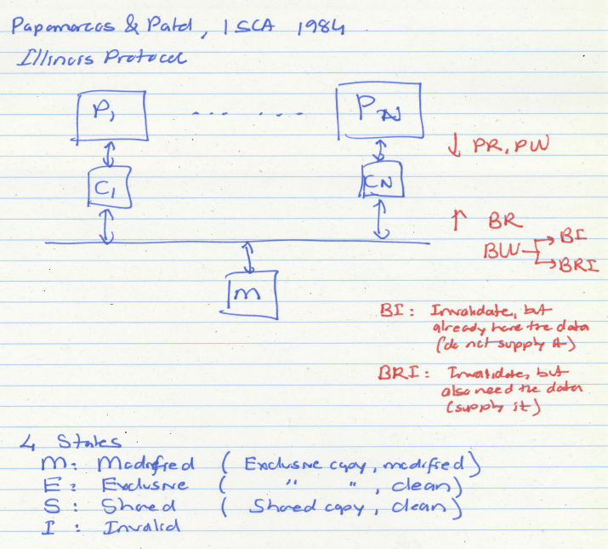

Slide 55
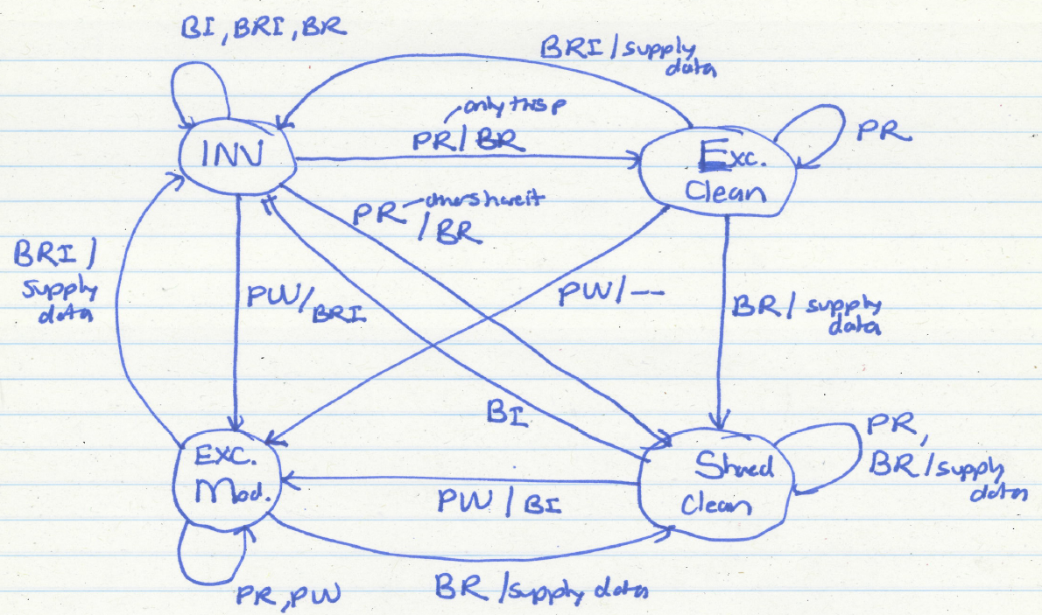
MESI State Machine

Slide 56
MESI State Machine
M
PrWr/--
BusRd/Flush
PrWr/BusRdX
E
BusRd/ $ Transfer
PrWr/BusRdX
S
PrRd (S’)/BusRd
PrRd (S)/BusRd
I
BusRdX/Flush (all incoming)
[Culler/Singh96]

Slide 57
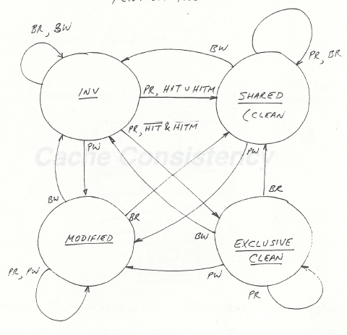
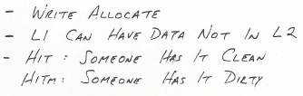
Intel Pentium Pro
Slide credit: Yale Patt

Slide 58
Snoopy Invalidation Tradeoffs
Should a downgrade from M go to S or I?
  S: if data is likely to be reused (before it is written to by another processor)
  I: if data is likely to be not reused (before it is written to by another)
Cache-to-cache transfer
  On a BusRd, should data come from another cache or memory?
  Another cache
    may be faster, if memory is slow or highly contended
  Memory
    Simpler: no need to wait to see if cache has data first
    Less contention at the other caches
    Requires writeback on M downgrade
Writeback on Modified->Shared: necessary?
  One possibility: Owner (O) state (MOESI protocol)
    One cache owns the latest data (memory is not updated)
    Memory writeback happens when all caches evict copies

Slide 59
The Problem with MESI
Shared state requires the data to be clean
  i.e., all caches that have the block have the up-to-date copy and so does the memory
Problem: Need to write the block to memory when BusRd happens when the block is in Modified state
Why is this a problem?
  Memory can be updated unnecessarily → some other processor may want to write to the block again while it is cached

Slide 60
Improving on MESI
Idea 1: Do not transition from M→S on a BusRd. Invalidate the copy and supply the modified block to the requesting processor directly without updating memory
Idea 2: Transition from M→S, but designate one cache as the owner (O), who will write the block back when it is evicted
  Now “Shared” means “Shared and potentially dirty”
  This is a version of the MOESI protocol

Slide 61
Tradeoffs in Sophisticated Cache Coherence Protocols
The protocol can be optimized with more states and prediction mechanisms to
  + Reduce unnecessary invalidates and transfers of blocks
However, more states and optimizations
  -- Are more difficult to design and verify (lead to more cases to take care of, race conditions)
  -- Provide diminishing returns

Slide 62
Snoopy Cache vs. Directory Coherence
Snoopy Cache
  + Miss latency (critical path) is short: miss → bus transaction to memory
  + Global serialization is easy: bus provides this already (arbitration)
  + Simple: adapt bus-based uniprocessors easily
  - Relies on broadcast messages to be seen by all caches (in same order):
  → single point of serialization (bus): not scalable
  → need a virtual bus (or a totally-ordered interconnect)
Notes:
Make reference to SGI Origin paper

Slide 63
Snoopy Cache vs. Directory Coherence
  Directory
  - Adds indirection to miss latency (critical path): request → dir. → mem.
  - Requires extra storage space to track sharer sets
    Can be approximate (false positives are OK)
  - Protocols and race conditions are more complex (for high-performance)
  + Does not require broadcast to all caches
  + Exactly as scalable as interconnect and directory storage
  (much more scalable than bus)
Notes:
Make reference to SGI Origin paper

Slide 64
Review: Memory Consistency
  Lamport, “How to Make a Multiprocessor Computer That Correctly Executes Multiprocess Programs,” IEEE Transactions on Computers, 1979 (less than 2 pages)
  Boehm et al., “Foundations of the C++ Concurrency Memory Model”, PLDI 2008 (11 pages)

Slide 65
CSC 2224: Parallel Computer Architecture and Programming
Memory Consistency &
Cache Coherence
Prof. Gennady Pekhimenko
University of Toronto
Fall 2019
The content of this lecture is adapted from the lectures of
Onur Mutlu @ CMU

